Slide 1

BOROSA – Bosch Road Safety Hackathon 2024
BHARATI VIDYAPEETH'S COLLEGE OF ENGINEERING FOR WOMEN, PUNE
by Team Vision Riders
Participants Name - Anushruti Adhikari,
Sae Jamdade,
Apurva Gadilkar.

Slide 2
Enhancing Rider Awareness
Rear-End Collision Detection
1
Continuously monitors 300-degree space, alerts rider of objects within 1.5m.
2
Blind Spot Detection
Identifies vehicles in rider's blind spots up to 1.5m away, provides visual alerts.
Lane Change Assist
3
Detects nearby vehicles during lane changes, warns rider with LED indicators.

Slide 3
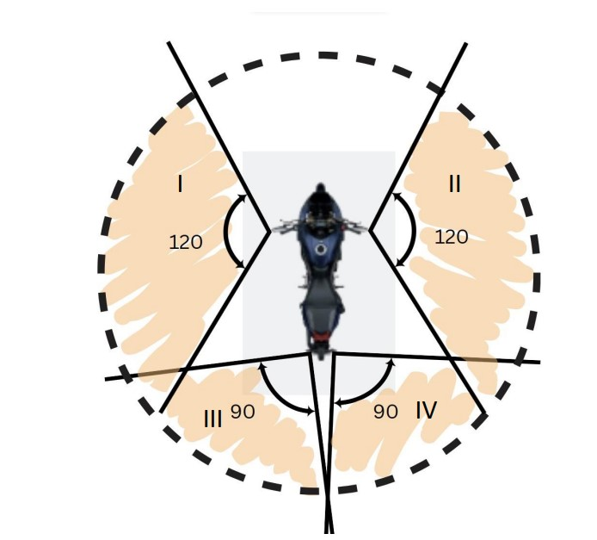
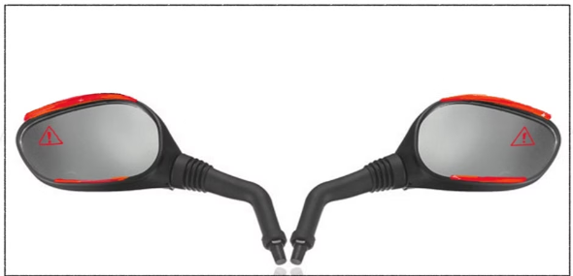
Innovative Solution

